Slide 1
NicheNet: cell-cell interaction and communication from gene expression
Advanced course – Single Cell Analysis Boot Camp
22nd-26th July 2024

Slide 2
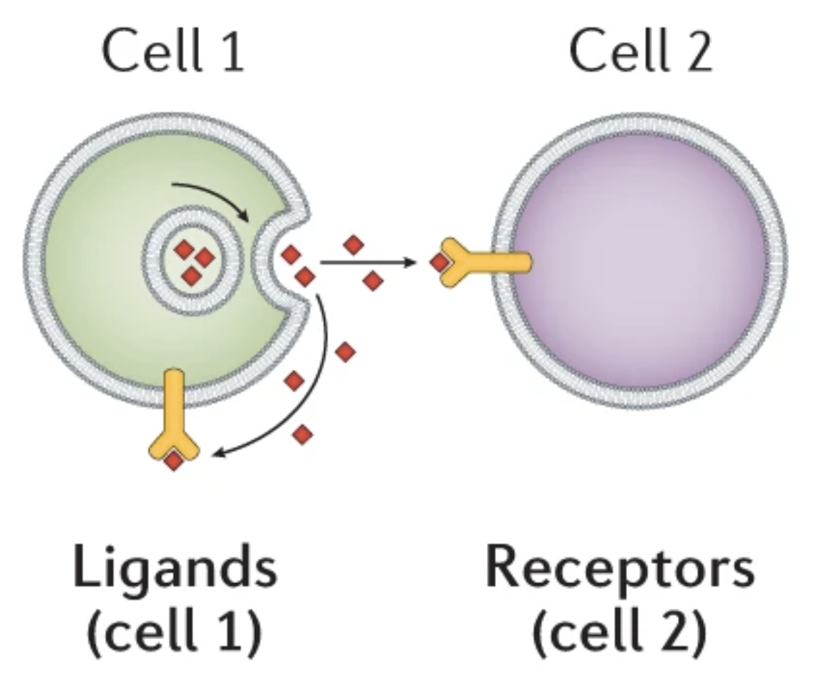
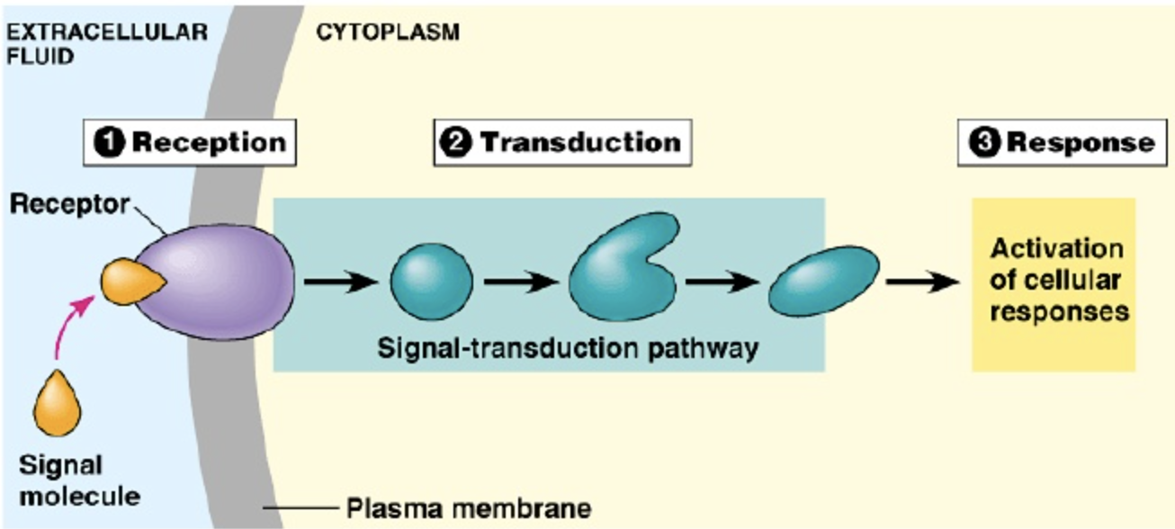
Cell-cell interaction (CCI)
Intercellular communication
+
Intracellular communication
Adapted from Armingol, E., Officer, A., Harismendy, O. et al. Deciphering cell–cell interactions and communication from gene expression. Nat Rev Genet 22, 71–88 (2021). https://doi.org/10.1038/s41576-020-00292-x

Slide 3
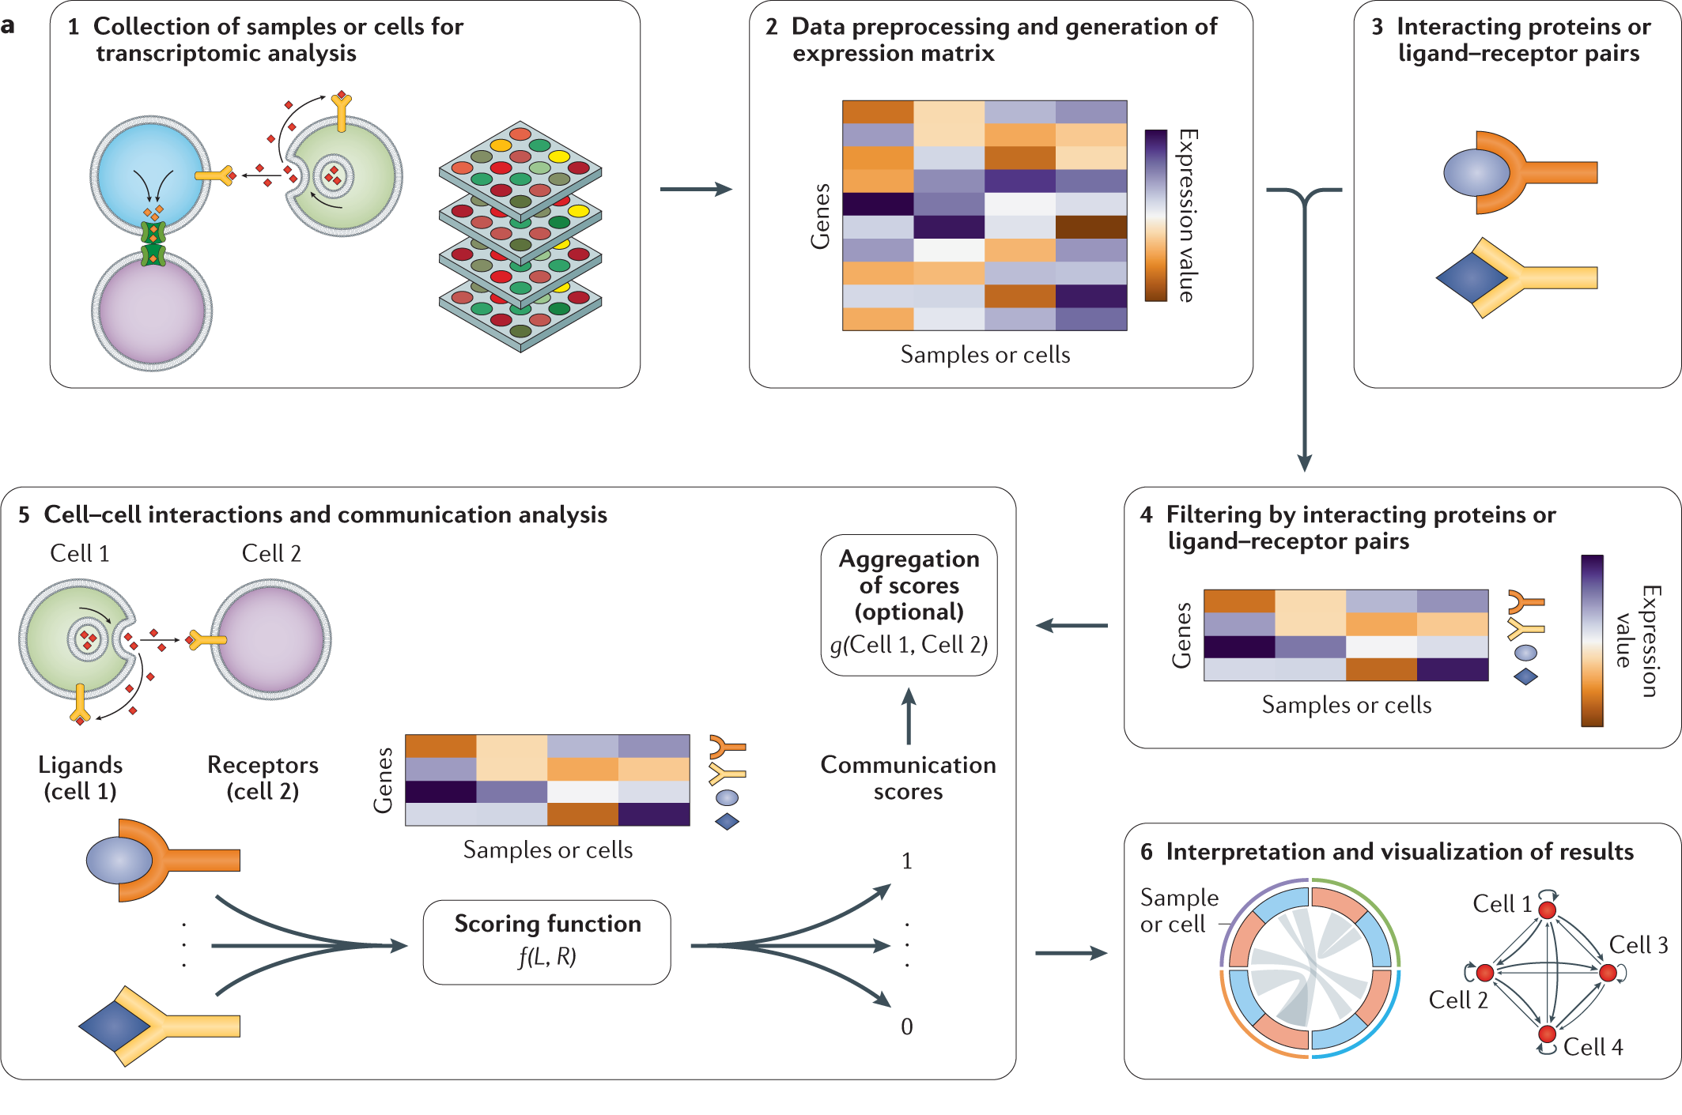
Infer CCI from single-cell data
Armingol, E., Officer, A., Harismendy, O. et al. Deciphering cell–cell interactions and communication from gene expression. Nat Rev Genet 22, 71–88 (2021). https://doi.org/10.1038/s41576-020-00292-x

Slide 4
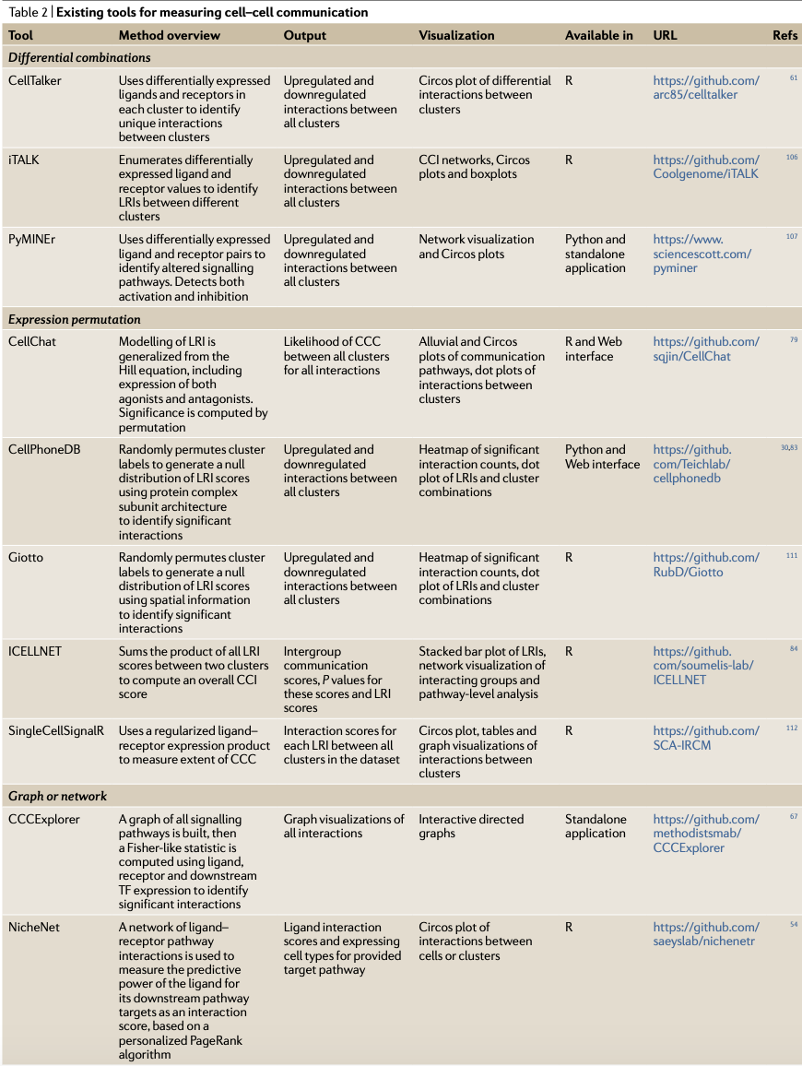
Tools to infer CCI from single-cell data
Armingol, E., Officer, A., Harismendy, O. et al. Deciphering cell–cell interactions and communication from gene expression. Nat Rev Genet 22, 71–88 (2021). https://doi.org/10.1038/s41576-020-00292-x

Slide 5
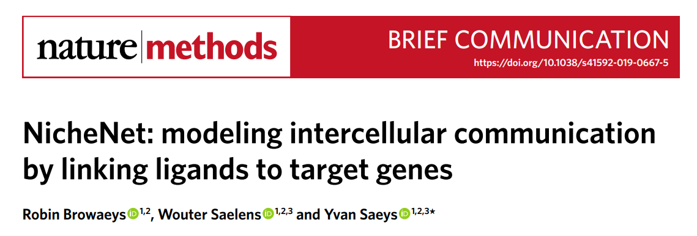
NicheNet: a network-based method
NicheNet predicts cell-cell interaction at single-cell level by combining gene expression data of interacting cells with prior knowledge on signaling and gene regulatory networks.
https://doi.org/10.1038/s41592-019-0667-5

Slide 6
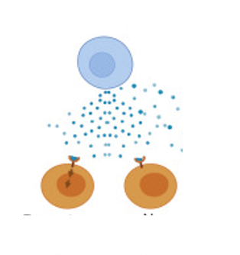
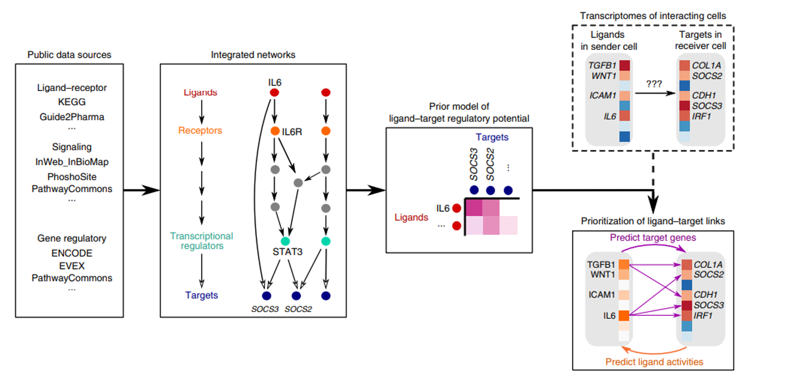
NicheNet: a network-based method
Interacting cells
Ligand-target links ?
sender cell
sender cell
which ligands from sender populations influence the expression of target genes in receiver?
which target genes are affected by each ligand?
which signaling mediators may be involved?
ligands
receiver cell
receiver cell

Slide 7
NicheNet: a network-based method
Gene expression data
Ligand-target prior model
Adapted from Browaeys, R., Saelens, W. & Saeys, Y. NicheNet: modeling intercellular communication by linking ligands to target genes. Nat Methods 17, 159–162 (2020). https://doi.org/10.1038/s41592-019-0667-5
Ligands-targets

Slide 8
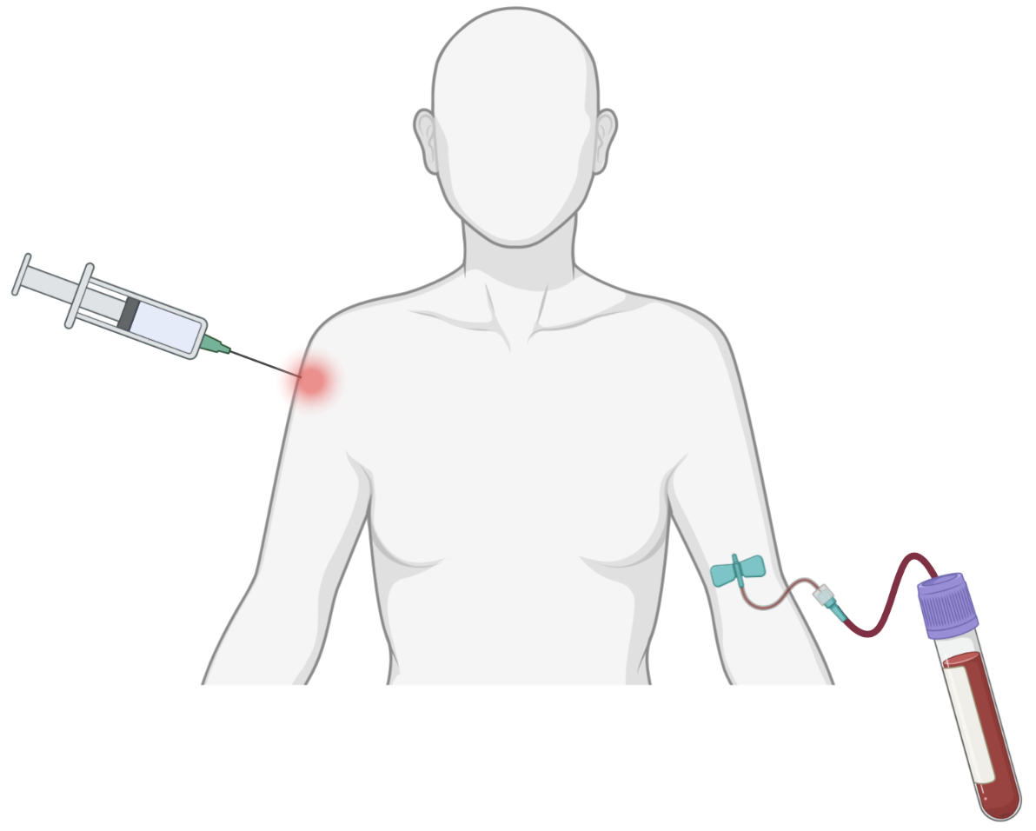
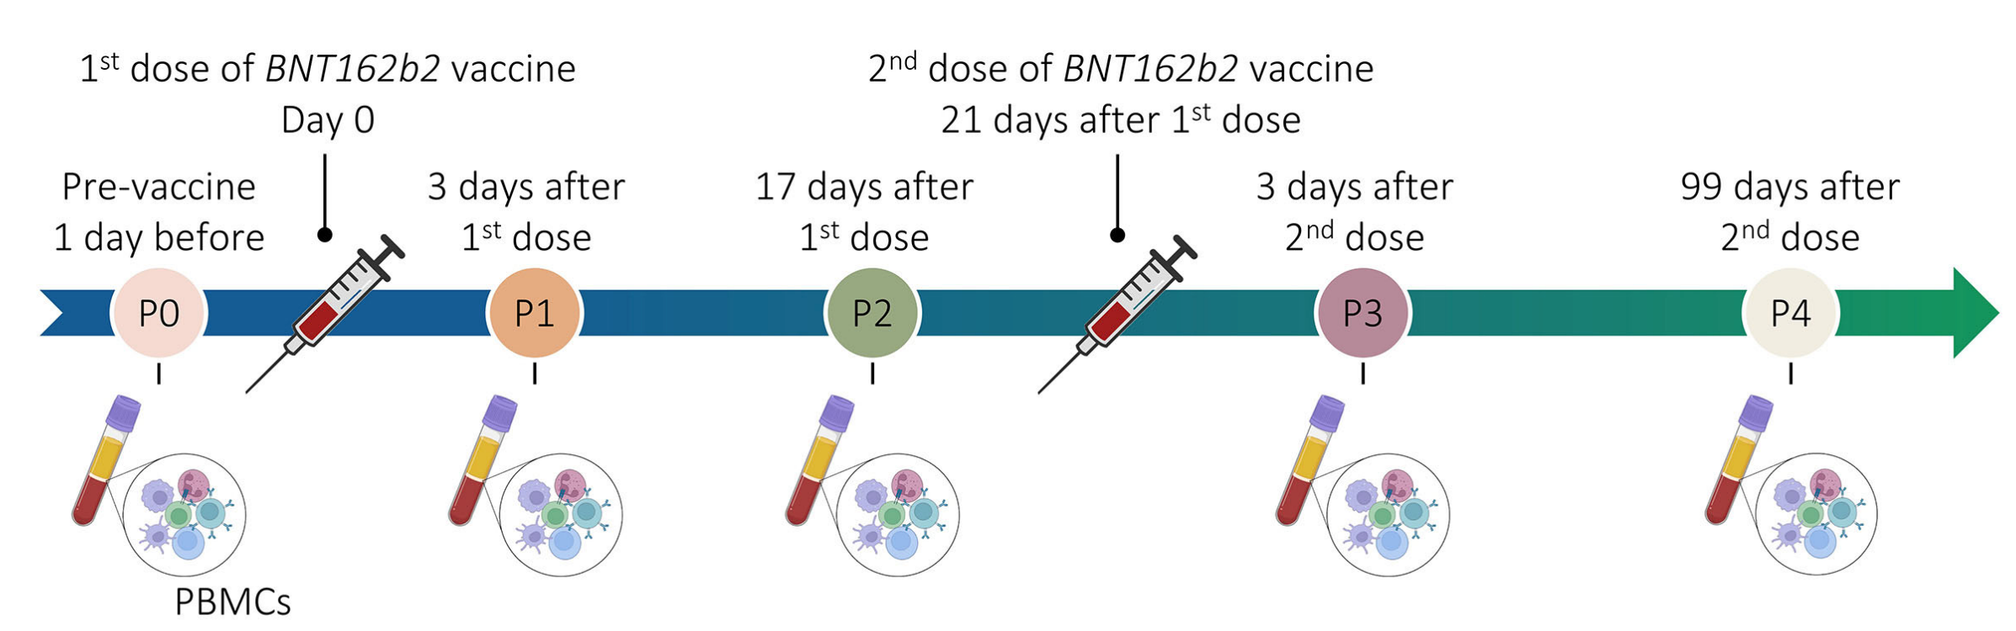

Case study VCOV cohort: experimental plan
Healthy vaccinated subjects
6 subjects
BNT162b2
vaccine
5’ scRNA sequencing
10X Chromium Genomics

Slide 9
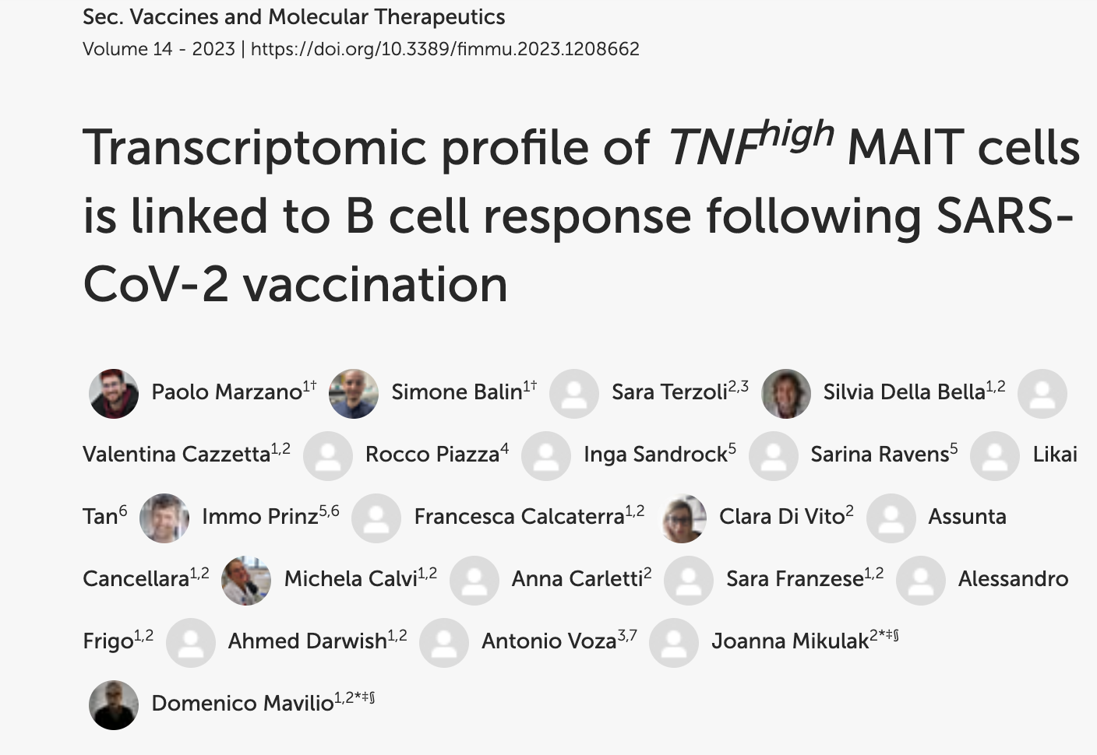
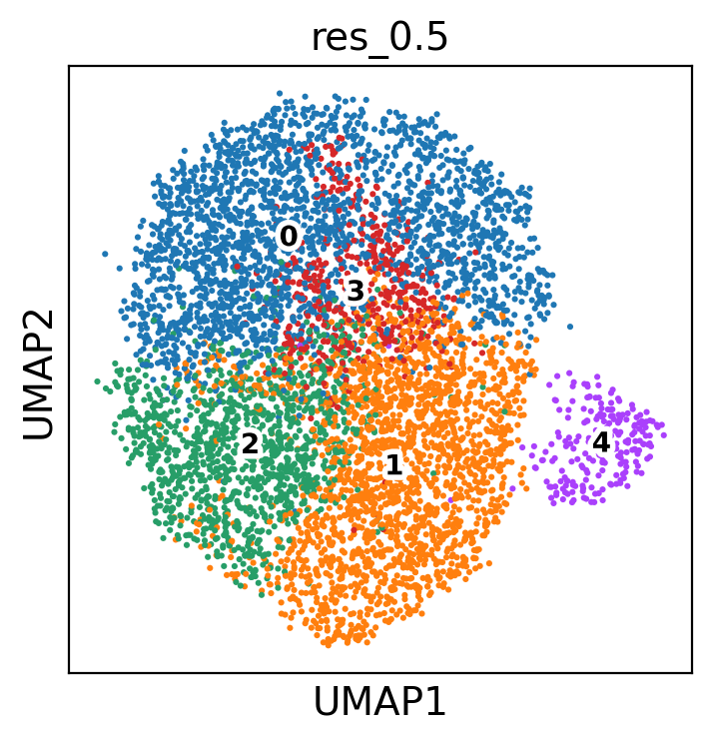
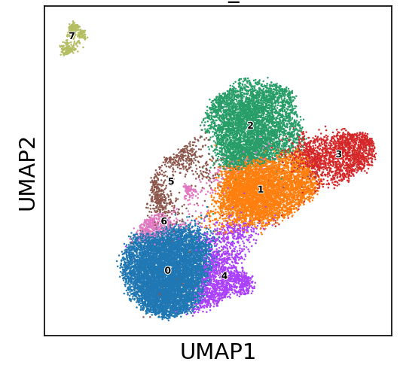
Case study: MAIT cell -B cell interaction in VCOV cohort
Predict which ligands expressed by MAIT cells at P3 are most likely to have induced the differential expression in B cells at P3 after BNT162b2 2° dose
MAIT cells at P3
B cells at P3
?
Gene set of interest

Slide 10
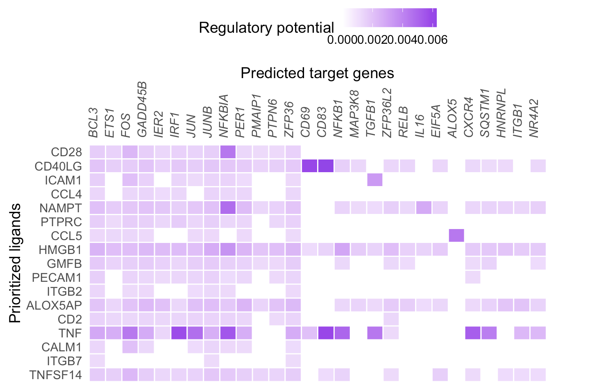
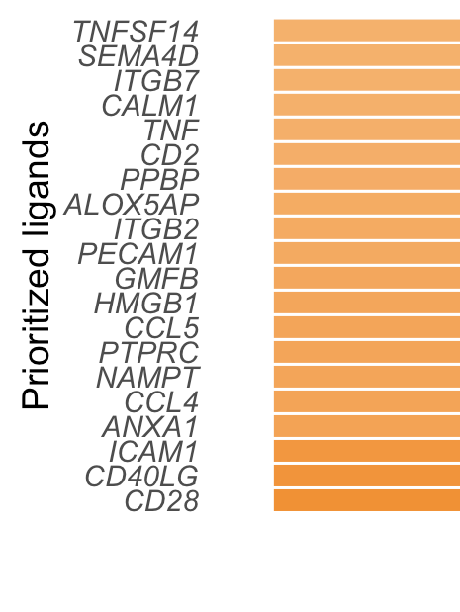
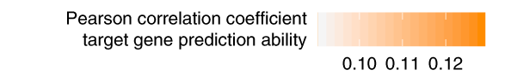
Case study: MAIT cell -B cell interaction in VCOV cohort
Ligand activity

Slide 11
Summary: steps of the analysis
Define a sender cell population
Define a receiver cell population
Determine which genes are expressed in both populations (at least 10% of cells in one cluster)
Load ligand-target prior model
Define a gene set of interest in receiver cell population
Perform NicheNet ligand activity analysis
Infer top-predicted target genes of ligands that are top-ranked in the ligand activity analysis

